Slide 1
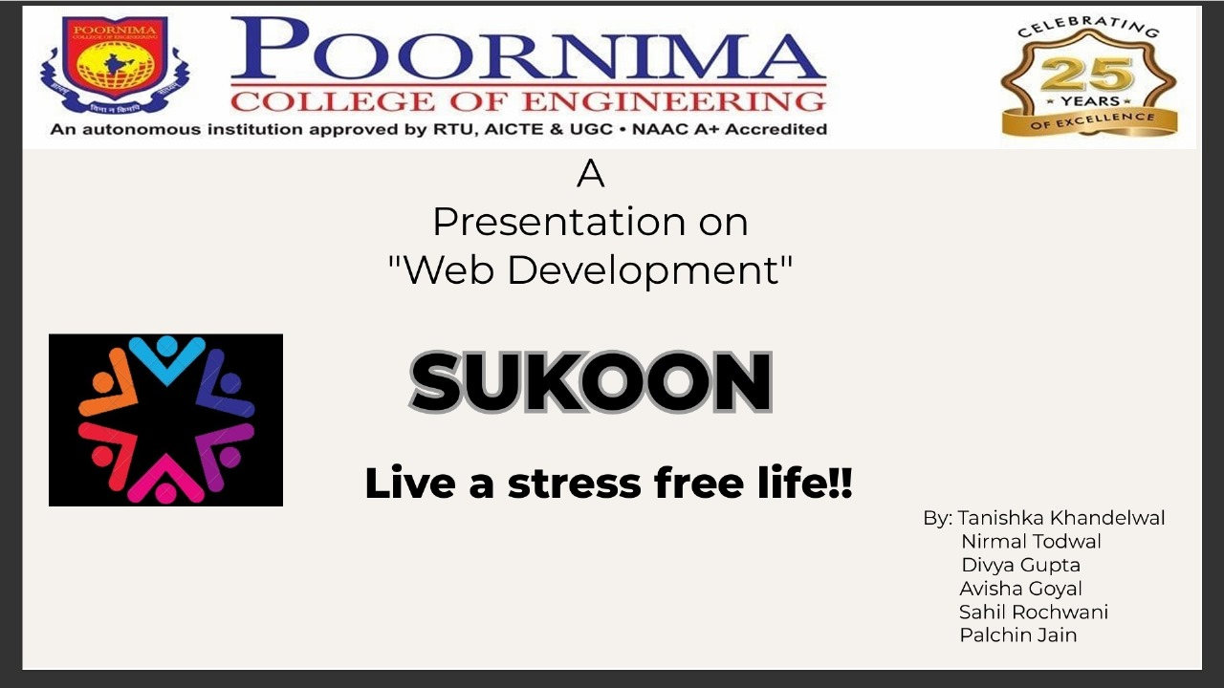
Presented to:
Ms. Shivani Jain
Designation: Faculty
Coordinators
Presented By:
Nirmal Todwal
Avisha Goyal
Samyak Jain
Sahil Rochwani

Slide 2
About Team
Project Name – Sukoon
Team Members
Nirmal Todwal
Samyak Jain
Avisha Goyal
Sahil Rochwani

Slide 3

IDEA TITLE
Solution Overview
The Website is designed to connect the people and using the website for therapy.
The user visit the website and get relief from stress and depression.
Get solution of their problems and improve their health.
Key Features
Online Therapy/Chat Support : Option for users to access virtual therapy sessions or chat with mental health professionals.
Guided Meditation & Relaxation : Offer audio or video guides for relaxation techniques, meditation, and stress-reduction practices.

Slide 4
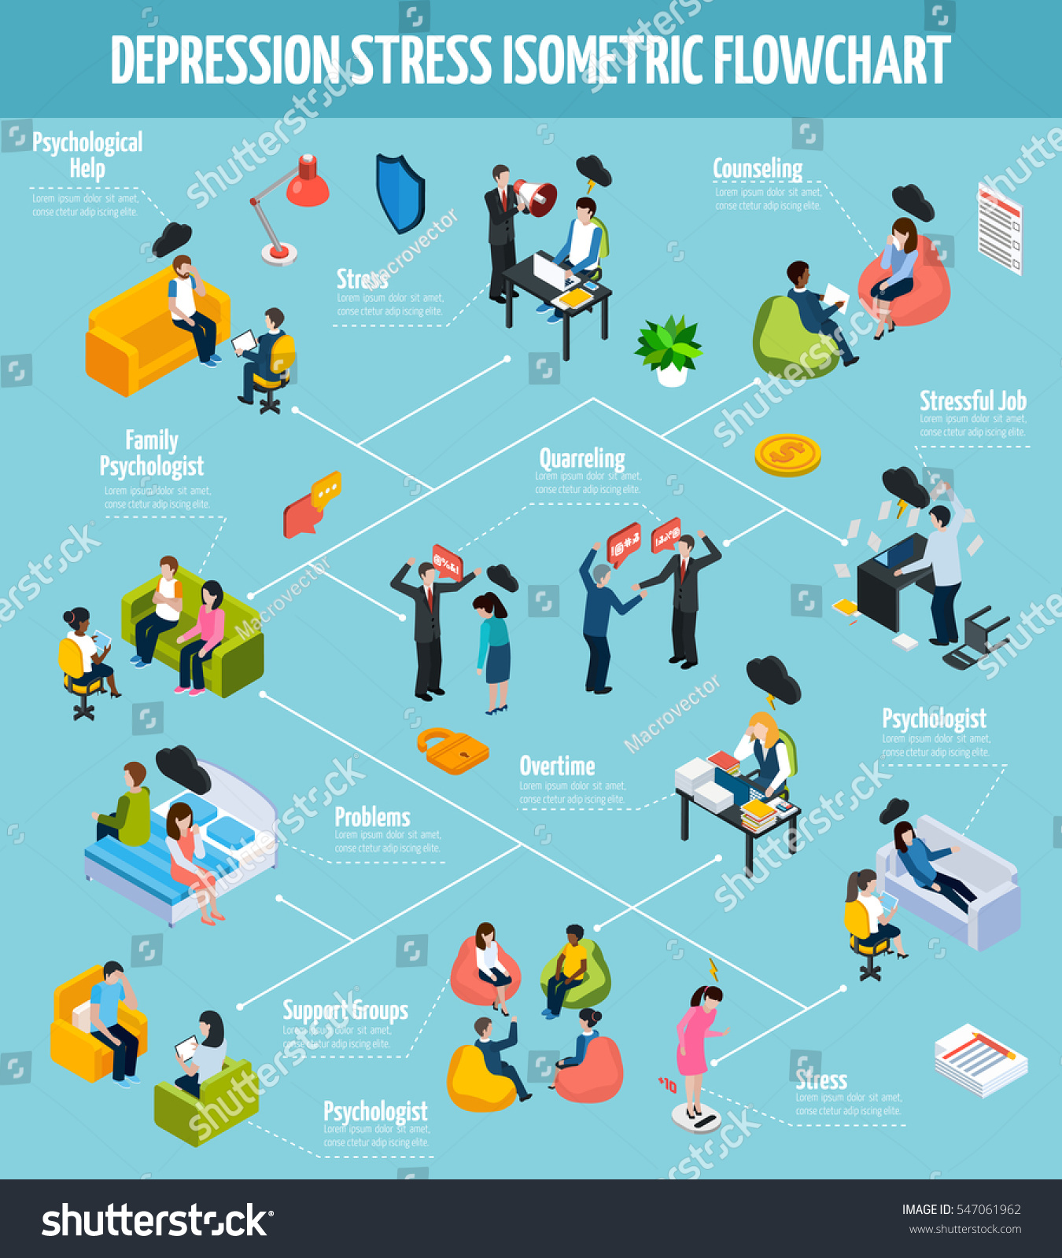
TECHNICAL APPROACH
Technologies to Use:
Frontend: HTML ,CSS, JS, Firebase
IDE used: VS code, Vercel

Slide 5
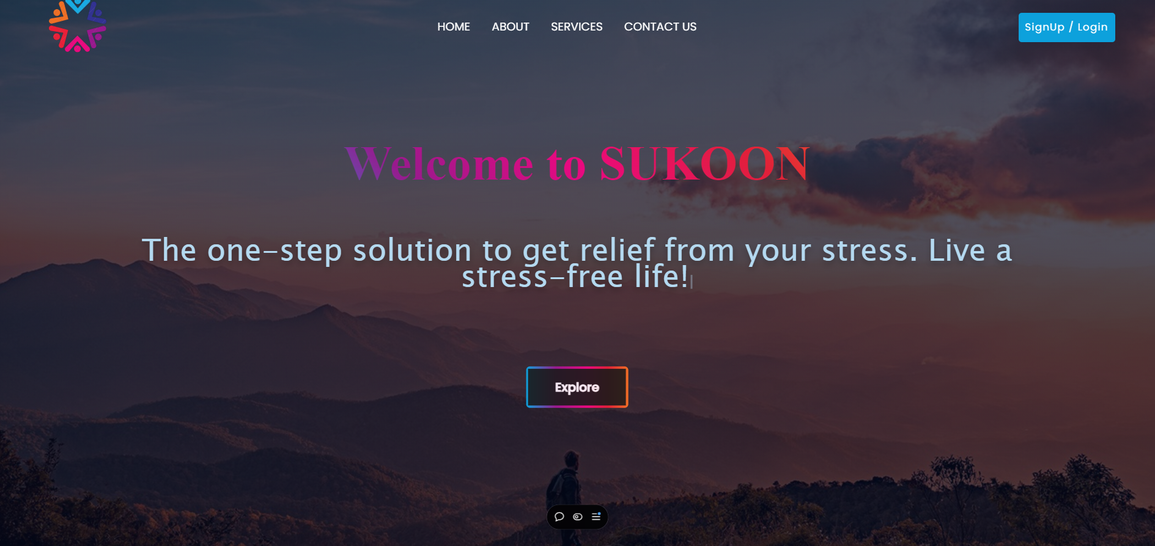
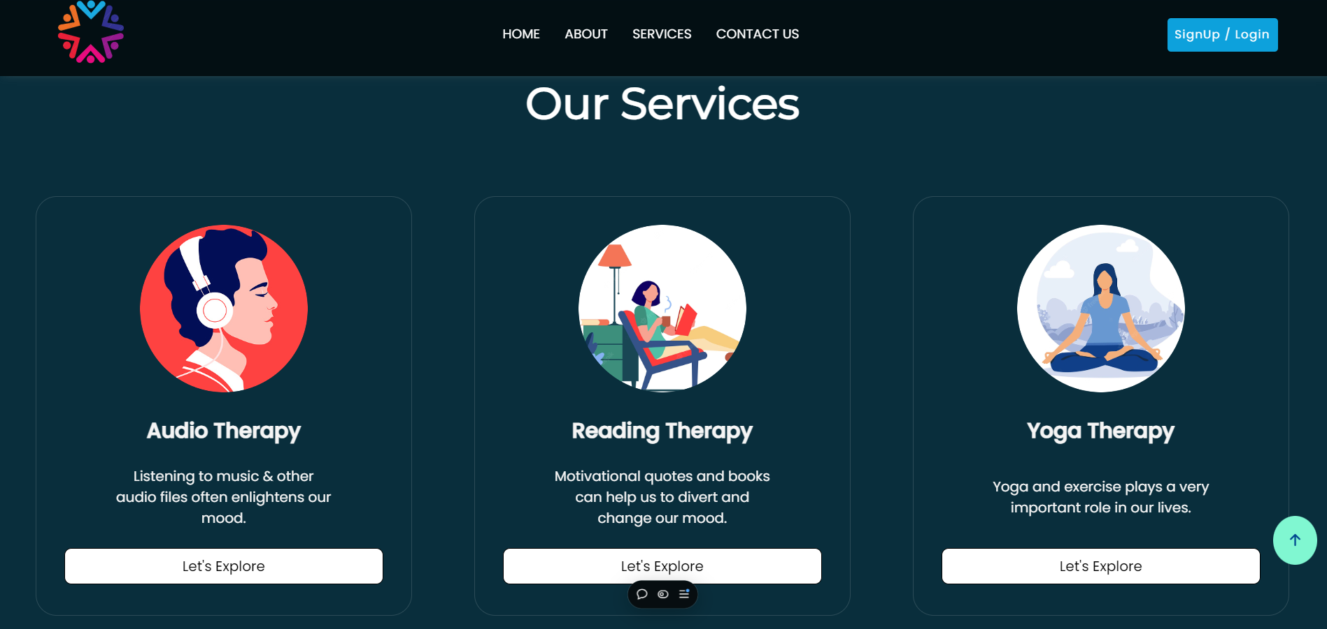
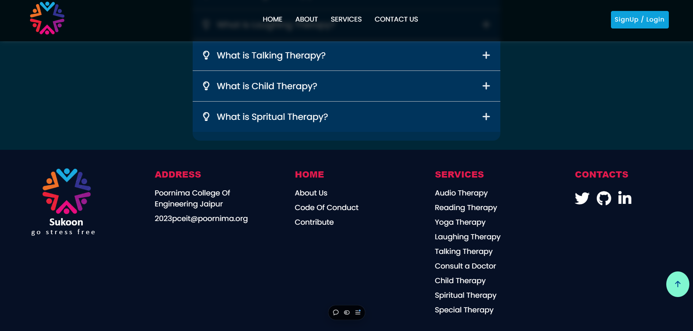
Snapshot and Images

Slide 6
FEASIBILITY AND VIABILITY
Feasibility:
Technologically feasible with existing tools (HTML, CSS, JS)
Low-cost web deployment with minimal infrastructure requirements.
Challenges:
Digital Literacy: Some People may struggle with app usage.
Internet Access: Rural areas may face connectivity issues.
Overcoming Challenges:
Easy User Interface: Provide Simple User interface with local languages.
Offline Features: Allow users to draft listings and complete transactions when connected

Slide 7
IMPACT AND BENEFITS
Social:
  Empowering Health
  Stress and Depression solving and improving Health
Environmental:
  The environment can influence either positively or negatively a person’s mental well-being. A recent study showed how the idea of living in the midst of the climate crisis was affecting Greenlander’s anxiety and depression levels. The effects of our changing climate—economic uncertainty, job insecurity, extreme and volatile weather patterns, and displacement—also influence mental health.

Slide 8
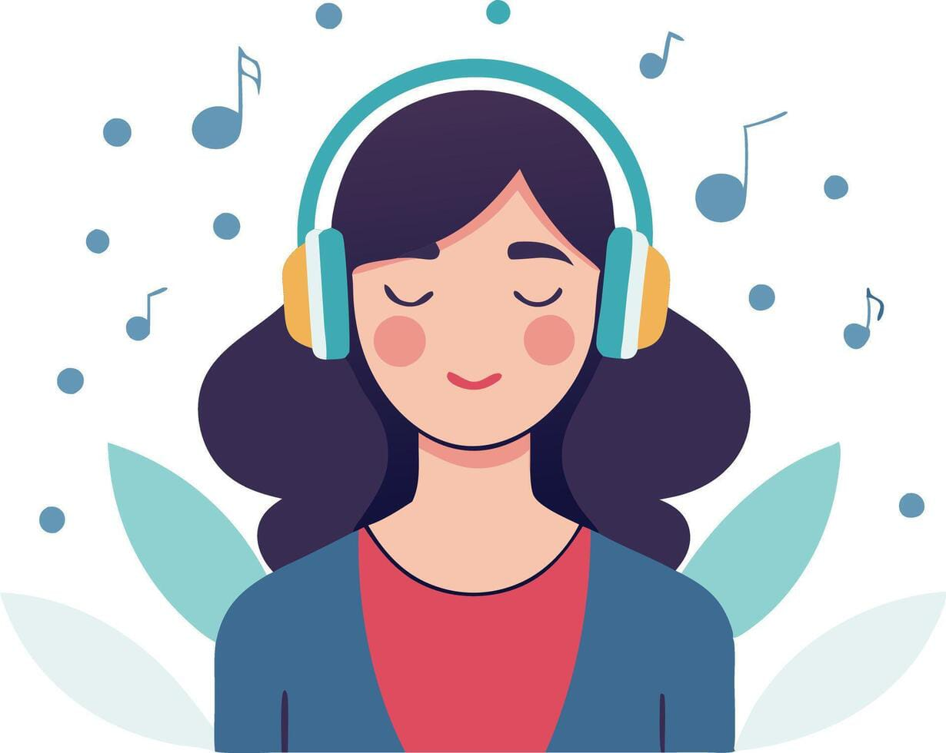
Audio Therapy
Is a powerful form of healing that uses sound, music, and other audio elements to promote emotional well-being and relaxation. Listening to music or soothing audio files can have a profound impact on our mood, often helping to reduce stress, alleviate anxiety, and elevate our spirits. Whether it’s a favorite song, the calming sounds of nature, or guided meditation tracks, audio therapy taps into the brain's response to rhythm and melody, creating a sense of comfort and joy. It’s an accessible and versatile way to improve mental health and foster a deeper sense of inner peace.

Slide 9

Reading Therapy
It also known as bibliotherapy, harnesses the power of words to heal and uplift our spirits. Engaging with motivational quotes, self-help books, or even uplifting fiction can provide a mental escape and offer new perspectives on life’s challenges. The process of reading helps divert our attention from stress and negative thoughts, allowing us to find comfort, inspiration, and guidance. Whether it’s a quote that resonates deeply or a book that provides a sense of hope, reading therapy can be a powerful tool for changing our mood, boosting resilience, and fostering personal growth.

Slide 10
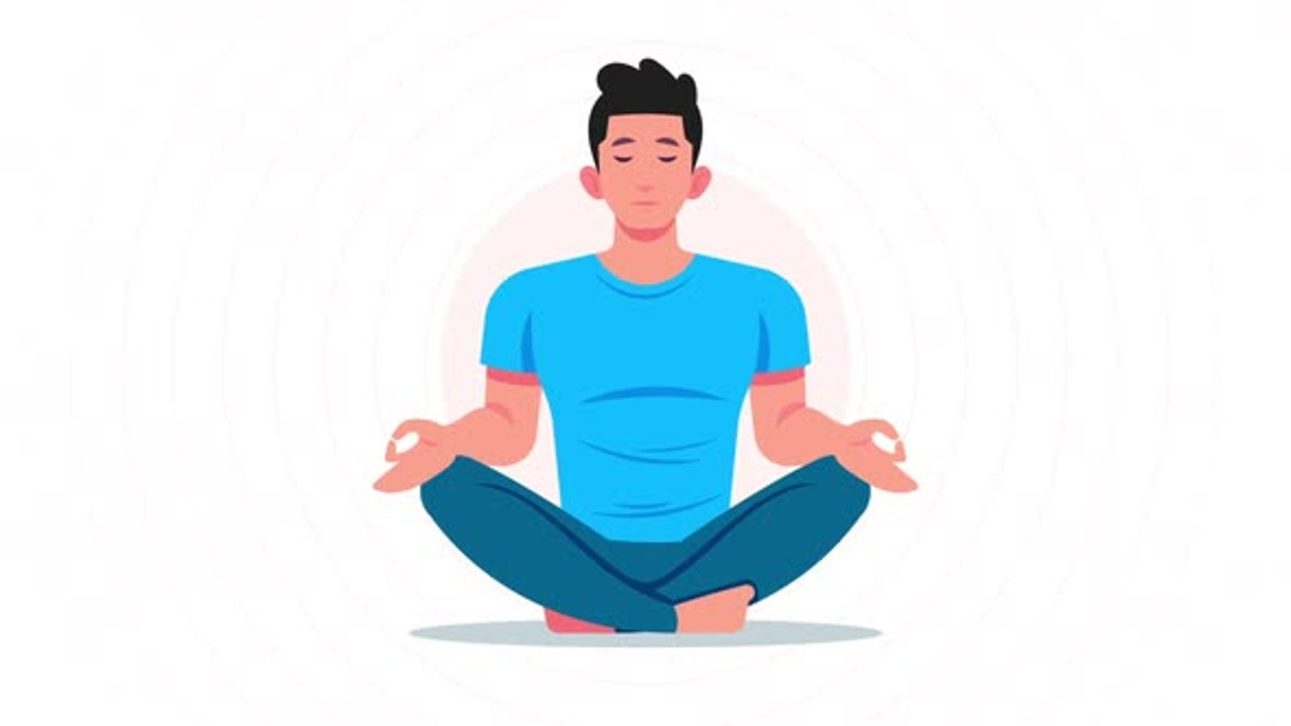
Yoga Therapy
It is a holistic approach that uses the principles of yoga to promote physical, mental, and emotional well-being. Incorporating yoga and exercise into daily life offers immense benefits, such as improving flexibility, enhancing strength, and boosting cardiovascular health. More than just physical activity, yoga integrates mindful breathing and meditation, helping to reduce stress and body and mind, facilitating healing and self-awareness. Regular practice can enhance mood, increase energy levels, and provide a natural way to manage life’s challenges, making it an essential component of a balanced lifestyle.

Slide 11
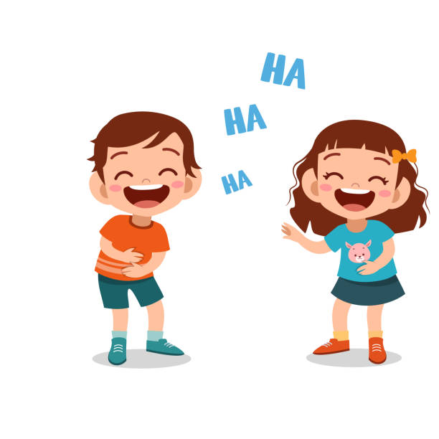
Laughing Therapy
It also known as laughter yoga or humor therapy, is a simple yet powerful practice that harnesses the natural benefits of laughter to improve our well-being. Laughter is often called the best medicine because it triggers the release of endorphins, the body’s natural feel-good hormones, which help reduce stress, alleviate pain, and boost our mood. Engaging in laughing exercises or simply sharing a good laugh with others can quickly refresh the mind, relax the body, and create a sense of joy and connection. By encouraging a playful spirit, laughing therapy offers a natural, effective way to lift our mood and bring a sense of lightness to our day.

Slide 12
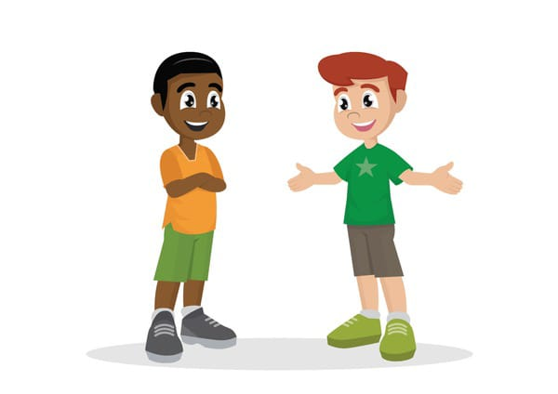
Talking Therapy
It also known as conversational or verbal therapy, taps into the power of communication to boost mental well-being. Even a short, light-hearted conversation with a friend, loved one, or therapist can bring a smile to our face and offer relief from stress. Sharing our thoughts and feelings helps to release emotional tension, gain clarity, and feel supported. It’s not just about the words we exchange, but the connection we build, which can provide comfort and a sense of belonging. Whether it’s casual chit-chat or a deeper discussion, talking therapy can uplift our spirits and foster a positive mindset.

Slide 13
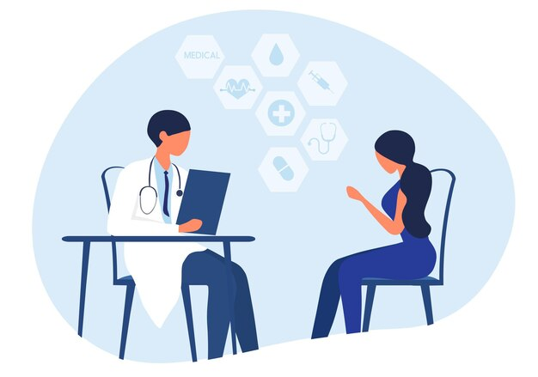
Consulting a Doctor
It is crucial when dealing with persistent or overwhelming health issues, whether physical or mental. While self-care practices and lifestyle changes can be helpful, a doctor’s expertise is essential for diagnosing underlying conditions and providing tailored treatment plans. If you’re experiencing prolonged discomfort, unexplained symptoms, or heightened emotional distress, it’s important not to ignore these signals. Consulting a healthcare professional can offer clarity, guide you toward appropriate solutions, and help prevent potential complications. Seeking medical advice early can lead to better outcomes, ensuring you get the right support to regain your well-being.

Slide 14
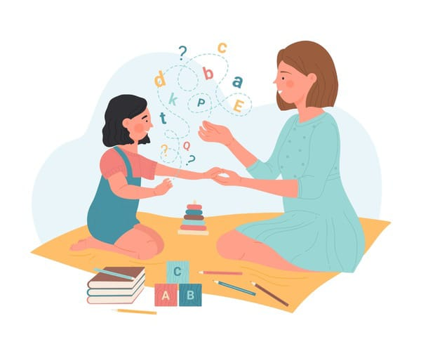
Child Therapy
Is a specialized approach designed to support the mental and emotional well-being of children. Their innocence and natural curiosity can often bring joy and help adults momentarily forget about their worries. However, children themselves may sometimes need help navigating their own emotions and experiences. Child therapy provides a safe space for young minds to express themselves, process their feelings, and develop healthy coping strategies. Through play, art, storytelling, and gentle conversation, therapists help children understand and manage their emotions. This type of therapy not only addresses specific issues but also nurtures resilience, boosting a child’s confidence supporting their overall development.

Slide 15
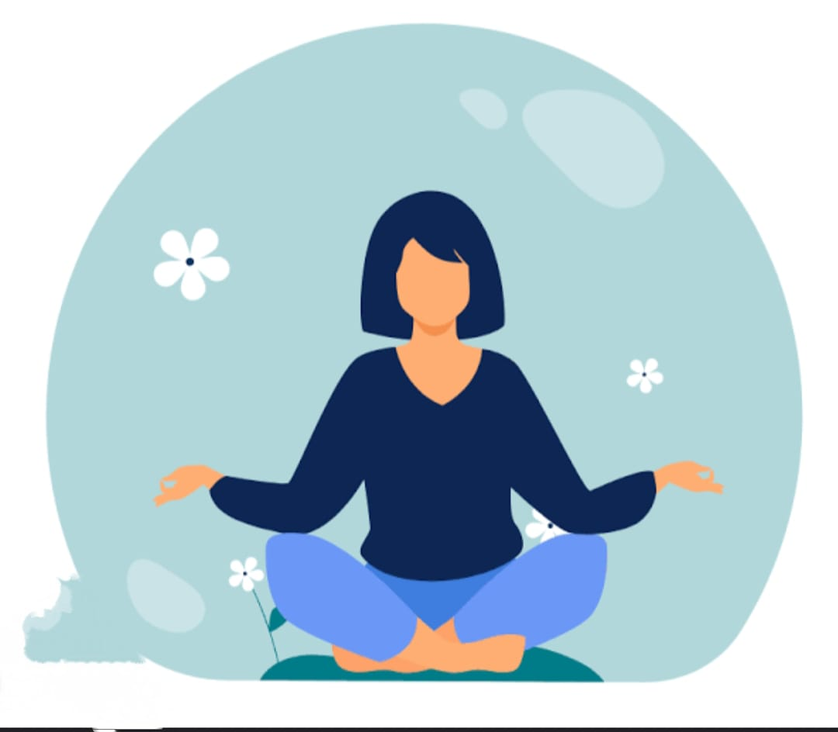
Spiritual Therapy
It is an approach that focuses on nurturing the soul and fostering a deeper connection to one's inner self and the universe. It emphasizes mindfulness, helping individuals to become more aware of their thoughts, emotions, and actions. By engaging in spiritual practices such as meditation, prayer, or reflection, spiritual therapy encourages individuals to gain clarity, find purpose, and develop a sense of peace. It teaches you to cultivate positive thinking, release negative patterns, and achieve emotional balance. Through this process, you learn to quiet the mind, embrace the present moment, and connect with a higher sense of meaning, leading to greater emotional and spiritual well-being.

Slide 16
Special Therapy
It is designed for individuals who require personalized care and tailored support to address specific challenges. Whether dealing with physical, emotional, or psychological difficulties, special therapy provides the attention and resources needed to aid in healing and personal growth. If you feel overwhelmed or need extra assistance, this therapy offers a compassionate space where professionals can work with you one-on-one, understanding your unique needs. Through specialized techniques, therapies, and interventions, we ensure that you receive the care and guidance you need, helping you feel empowered and supported on your journey to recovery and well-being.

Slide 17
Thanks!

